Slide 1
SO YOU’RE THE DEAN AND/OR IN DEVELOPMENT…
NOW WHAT?
Tom Hadzor
Director of Development
Duke University Libraries
ALADN
May 19-22, 2013

Slide 2
A little definition…
Identify
Cultivate
Solicit
Steward
Development is a process of bringing people closer to your work and engaging them in it.

Slide 3
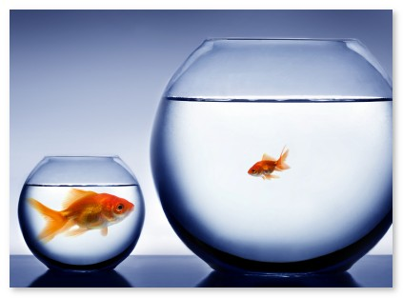
A little definition…
The work is always the same. It only differs by matters of scale.

Slide 4
The process can be quick, or it can take years.
Generally, it will take a year and a half to two years.

Slide 5
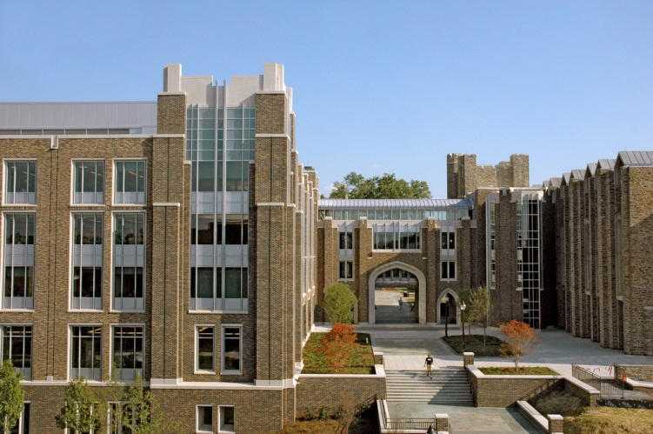
People give because…
They believe in the cause
Leadership
Relationships
Recognition
Tax or financial considerations
They are grateful to the cause
To honor or memorialize

Slide 6
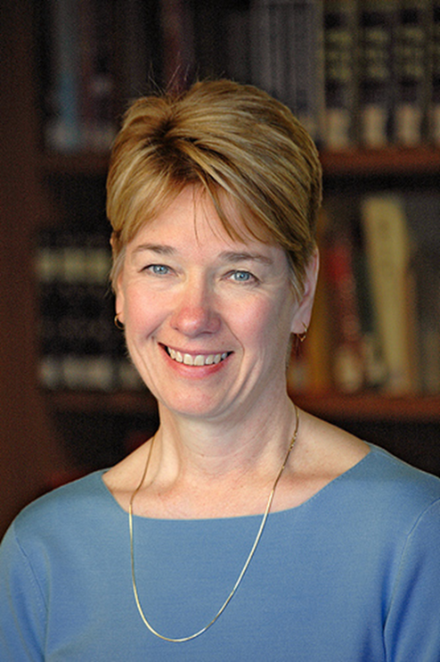
People give because…
They believe in the cause
Leadership
Relationships
Recognition
Tax or financial considerations
They are grateful to the cause
To honor or memorialize

Slide 7
People give because…
They believe in the cause
Leadership
Relationships
Recognition
Tax or financial considerations
They are grateful to the cause
To honor or memorialize

Slide 8
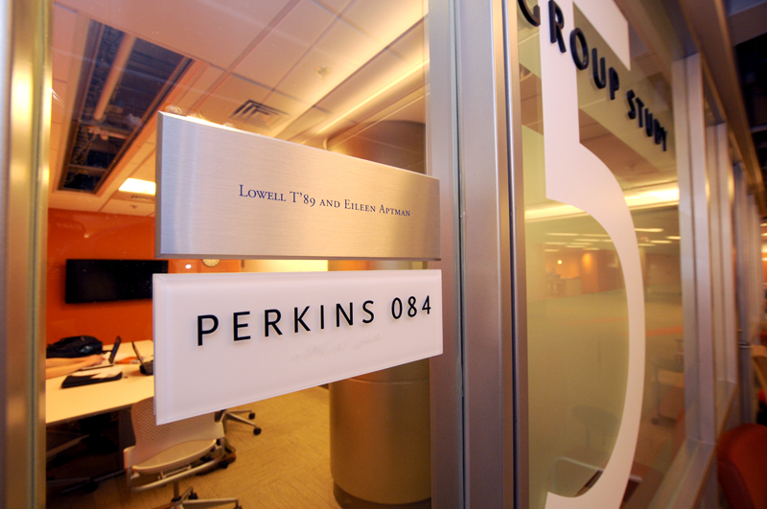
People give because…
They believe in the cause
Leadership
Relationships
Recognition
Tax or financial considerations
They are grateful to the cause
To honor or memorialize

Slide 9
People give because…
They believe in the cause
Leadership
Relationships
Recognition
Tax or financial considerations
They are grateful to the cause
To honor or memorialize

Slide 10
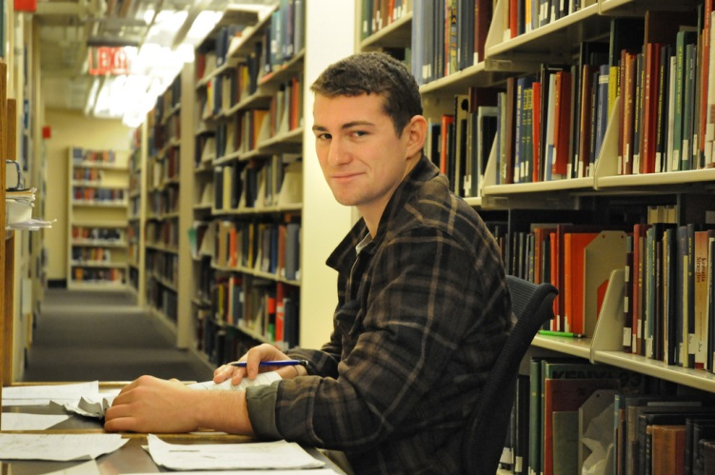
People give because…
They believe in the cause
Leadership
Relationships
Recognition
Tax or financial considerations
They are grateful to the cause
To honor or memorialize

Slide 11
People give because…
They believe in the cause
Leadership
Relationships
Recognition
Tax or financial considerations
They are grateful to the cause
To honor or memorialize

Slide 12
How do we ask?
Mail
Email
Video
Phone
1 on 1
Which do you think is most effective?

Slide 13
Who should you focus on?

Slide 14
97% of your gifts will be given by 3% of your donors.

Slide 15
HOW DO YOU IDENTIFY TOP PROSPECTS?

Slide 16
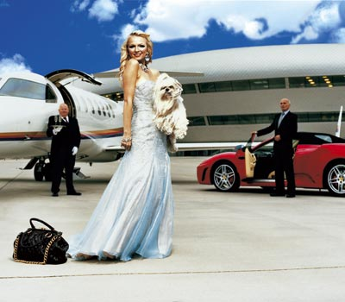
Train your ear for messages about businesses, lifestyle, homes, vacations and travel, stocks, cars, boats, planes, clubs, private foundations…

Slide 17
Listen to those who say they want to help.

Slide 18
Think about past patrons, those who really benefit from you.

Slide 19
Talk about your philanthropic needs.

Slide 20
Consider, right now, your top 5 prospects.

Slide 21
Development is an attitude and a mindset.

Slide 22
Of individuals, corporations, and foundations, the greatest of these is individuals!

Slide 23
SHAMELESS PLUG
Where do prospects come from?
Kurt Cumiskey
Assistant Director of Development, Duke University Libraries
Monday, May 20
1:00 PM

Slide 24
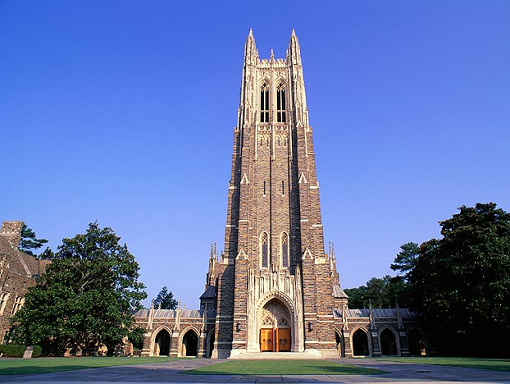
Know your institution and your library. You represent both!

Slide 25
Development is a team sport. Involve others in the libraries, university development, and administration.

Slide 26
Realize the importance of other development professionals in:
Alumni Association
Communications
Prospect Research
Special Events
Phonathons
Stewardship
Gift Planning
IT

Slide 27
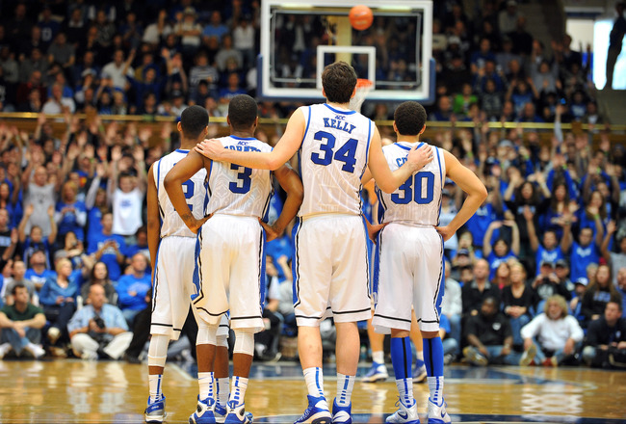
Work well and play well with others!

Slide 28
Pay attention to prospect management.

Slide 29
Work inside the system, but push… pound on tables and throw some elbows!

Slide 30
?
What are you raising money for?

Slide 31
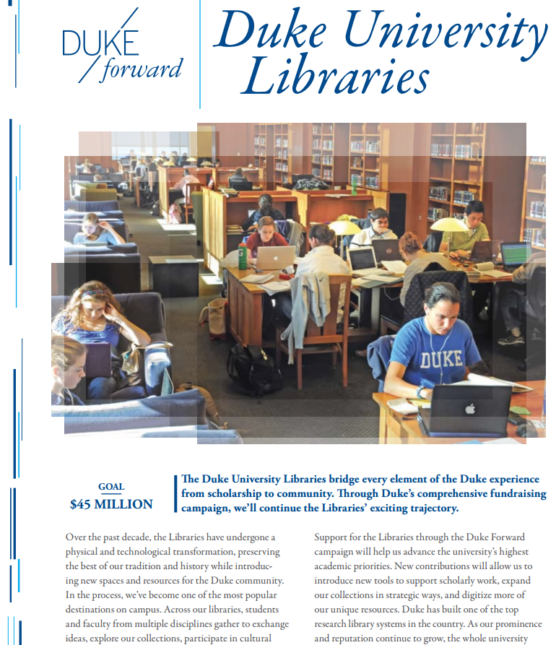
Have a compelling case statement
(in both print and electronic formats).

Slide 32
How does the fundraising help you meet your strategic plans?

Slide 33
HOW DO YOU
ASK?

Slide 34
It’s a conversation. Tell stories about your library and its needs. Make the request.
Would you be willing to consider a gift of $________?

Slide 35
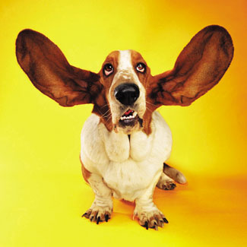
Prepare to be quiet and listen.

Slide 36
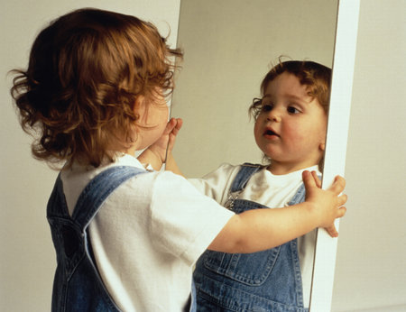
Practice in the mirror. Really!

Slide 37
Ask. You must ask! Be bold!

Slide 38
What are you asking for?
Annual Fund
Capital Project
Planned Gift
All three!

Slide 39
What are you asking for?
Annual Fund
Capital Project
Planned Gift
All three!

Slide 40
What are you asking for?
Annual Fund
Capital Project
Planned Gift
All three!

Slide 41
What are you asking for?
Annual Fund
Capital Project
Planned Gift
All three!

Slide 42
Make it easy to do business.

Slide 43
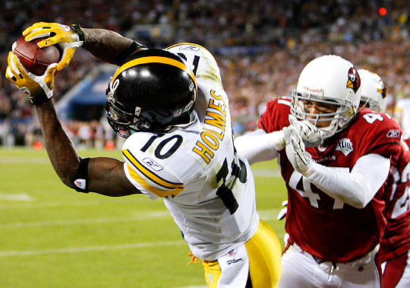
Try to keep the ball in your hands.

Slide 44
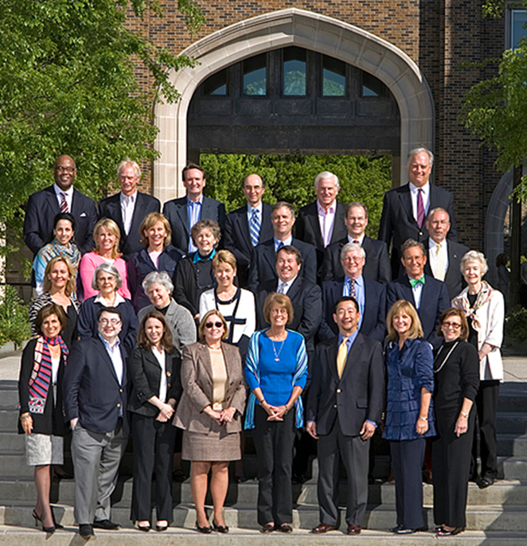
Engage others in your work.

Slide 45
Libraries are the home of technology on many campuses. Use it.

Slide 46
Your website, digital pictures, naming opportunities website, email and video solicitations, etc.

Slide 47
FOR YOUR CONSIDERATION

Slide 48
Deans: How much of your time should be devoted to development-oriented work?
40%

Slide 49
Is it run out of central development or do you have a dedicated office within the libraries?
Development, Director
Tom Hadzor
Development,
Assistant Director
Kurt Cumiskey
Communications, Director
Aaron Welborn
Graphic Designer
Mark Zupan
Exhibits Coordinator
Meg Brown
Development Assistant
Megan Crain

Slide 50
Budget for development
$
$$$$

Slide 51
Integrated computer systems

Slide 52
Swag!

Slide 53
It’s hard, but focus on the big things.

Slide 54
Play with confidence.

Slide 55
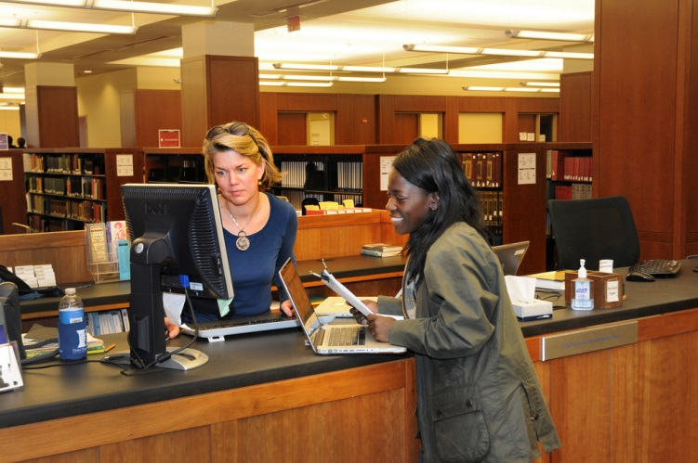
Your libraries deserve to find the best people who give their best efforts.

Slide 56
Questions and discussion

